Slide 1
Topic : SHELL MODEL of NUCLEUS Subject : NUCLEAR AND PARTICLE PHYSICS

Slide 2
Table of contents :
Nuclear shell model
Assumptions of nuclear shell model
Magic Numbers
Features of magic numbers

Slide 3
Why Nuclear Shell Model?
- The Liquid drop model could not explain various nuclear properties such as magic number, spin, parity electronic quadrupole momentum etc.
- These properties would be require us to consider the motion of individual nucleons in a potential well which would give rise to the existence of a nuclear shell structure, similar to electronic shells in the atom.
- As in the Atomic physics, there are inert gases or noble gas as He (Z=2), Ne (Z=10) etc, the outermost subshells are complete and electrons are tightly bound we say that these gases are stable

Slide 4
WHAT IS NUCLEAR SHELL MODEL?
In 1948 American Physicist M.G. Mayor and German Physicist J. Hans Jenson showed that nuclei containing some numbers of protons and neutrons showed stability.
The nuclear shell model is partly analogous to the atomic shell model, which describes the arrangement of electrons in an atom.
In this model number of protons or number of neutrons (separately) are these 2,8,20,28,50,82,126 then that nuclei will show high stability.

Slide 5
Assumptions of shell model :
The nucleons of the nucleus are arranged in some type of closed shell structure with a suitable number of protons and neutrons.
Each nucleon assumed to possess spin angular momentum and orbital angular momentum.
The existence of spherically symmetric central field of force governing the motion of individual nucleons inside the nucleus.

Slide 6
The central field or force in this case is assumed to be an average field due to all the nucleus so force on a nucleons will be same as on other nucleons.
Here we will discuss the motion of a single nucleon to desirable structure of nucleus, so this model is also known as single particle shell model.

Slide 7
MAGIC NUMBERS
The most widely use Magic Numbers are 2,8,20,28,50,82,126
The above numbers are popularly known as magic number and are analogous to the atomic number of inert gases.
In nuclear physics the magic number are the “ Number of neutrons or Number of protons such that the shell is complete within the atomic nucleus.
The nuclei with magic number are very stable.

Slide 8
Doubly Magic Number
Some Nuclei which have Magic Number of protons or neutron both and are equal to one of the magic number are called Doubly Magic Number.
For Example :
He2 (Z=2 , N = 2)
O8 (Z = 8 , N = 8 )
Ca20 (Z= 20, N = 20)

Slide 9
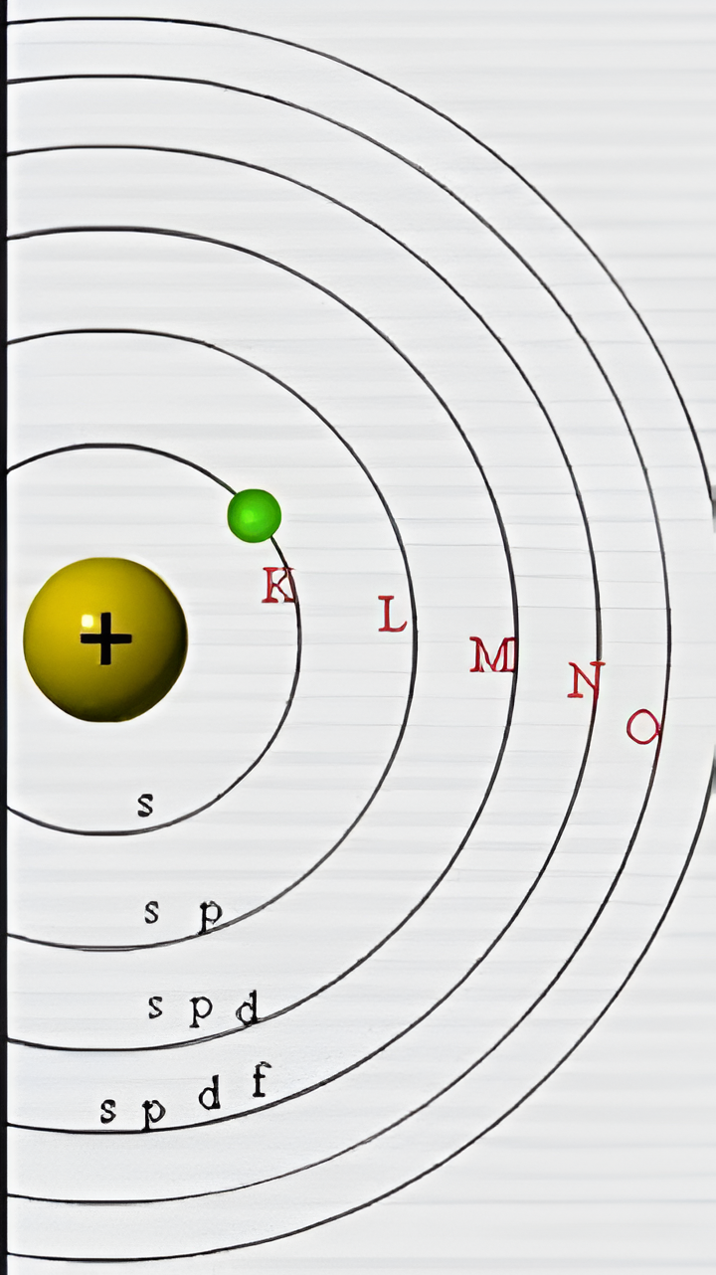
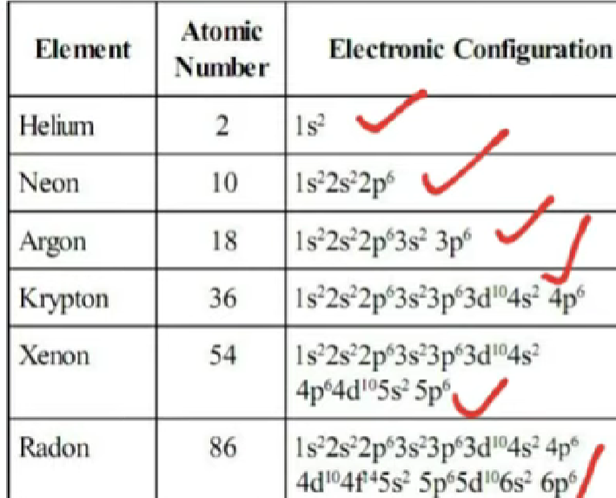

Slide 10
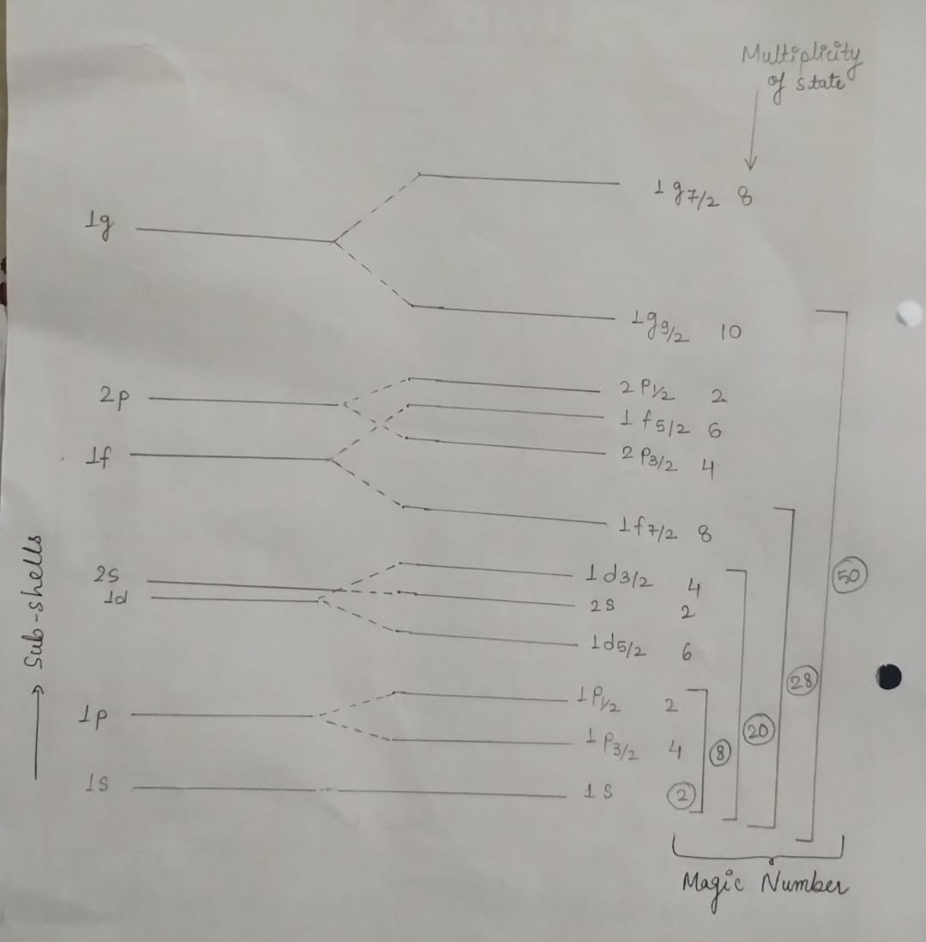

Slide 11
FEATURES OF MAGIC NUMBERS :
Nuclei containing magic number of protons or neutrons shows very high stability. These magic numbers were not explained in previous models.
If neutron (or proton) corresponds to magic number then we need greater energy to remove last neutron (or proton) that high energy is called as separation energy.

Slide 12
If both proton and neutron corresponds to magic number than they are most stable nuclei.
The number of stable isotopes of an element containing a magic number of proton is usually large as compared to those for others elements.
The number of Naturally occurring isotones with magic number of neutrons is usually large compared to those in the immediate neighbourhood.

Slide 13
Main Achievements of Shell Model :
It explain magic number.
It explain the magnetic moment of some nuclei.
It explain successfully ground state spin.
It explain greater stability and high binding energy.

Slide 14
Main Limitations of Shell Model :
It fails to explain the stability of stable nuclei as H, Li, N
It does not predict the correct values of nuclear spin for certain nuclei.

Slide 15


